Slide 1
Systems Analysis and Design
Course Code: CSE 305
Spring 2022 Semester
Instructor:
Shammi Akhtar
Asst. Prof. CSE Dept., UAP

Slide 2
The Feasibility Study
Systems Analysis and Design
The objective of a feasibility study is to find out if an information system project can be done, and if so, how.
A feasibility study should tell management:
  Whether the project can be done;
  What are alternative solutions?
  What are the criteria for choosing among them?
  Is there a preferred alternative?
After a feasibility study, management makes a go/no-go decision.

Slide 3
Dimensions of Feasibility
Systems Analysis and Design
Operational -- how will the solution work?
Technical -- is the technology needed available? Can we build it?
Economic -- return on investment. Should we build it?
Schedule -- can the system be delivered on time?
Organizational feasibility: If we build it, will they come?

Slide 4
Feasibility Analysis
1 | Technical Feasibility | Familiarity with application: Less familiarity generates more risk Familiarity with technology: Less familiarity generates more risk Project size: Large projects have more risk Compatibility: The harder it is to integrate the system with the company’s existing technology, the higher the risk will be
2 | Economic Feasibility | Return on Investment (ROI) Break Even Point (BEP) Intangible Benefit
3 | Organizational Feasibility | Is the software project strategically aligned with the business?

Slide 5
Technical Feasibility
Familiarity with application | Knowledge of business domain Need to understand improvements Need to recognize pitfalls and bad ideas
Familiarity with technology | Is technology new to this organization? Is this a brand new technology? Extension of existing firm technologies
Project size | Number of people, time, and features
Compatibility | Systems are not built in a vacuum Needs to integrate with current systems and data

Slide 6
Economic Feasibility
Information Systems Analysis and Design
The bottom line for many projects!
Economic feasibility amounts to judging whether possible benefits of the project are worthwhile.
As soon as a specific solution has been identified, the analyst can weigh the costs and benefits of each alternative.
This is called cost-benefit analysis.

Slide 7
Cost/Benefit Analysis
Information Systems Analysis and Design
The purpose of a cost/benefit analysis is to answer questions such as:
  Is the project justified (benefits outweigh costs)?
  Can the project be done, within cost constraints?
  What is the minimal cost to attain a certain system?
Difficulties -- discovering and assessing benefits and costs; they can both be intangible, hidden and/or hard to estimate, it's also hard to rank multi-criteria alternatives

Slide 8
Types of Benefits
Information Systems Analysis and Design
Benefits may be classified into one of the following categories:
  Monetary -- when $-values can be calculated;
  Tangible (Quantified) -- when benefits can be quantified, but $-values can't be calculated;
  Intangible -- when neither of the above applies.
How to identify benefits? By organizational level (operational, lower/middle/higher management) or by department (production, purchasing, sales,...)

Slide 9
Types of Costs
Information Systems Analysis and Design
Project-related costs
  Development and purchasing costs;
  Installation, training and conversion costs.
Operational costs (on-going)
  Maintenance: hardware, software, facilities
  Personnel: operation, maintenance.
For a small business that wants to introduce a PC-based information system, these cost categories amount to:
  Project costs: purchase hardware, software, furniture; customize software, train, install, file conversion
  On-going costs: operating the system (data entry, backups, helping users, vendors etc.), maintenance (software) and user support, hardware and software maintenance, supplies,...

Slide 10
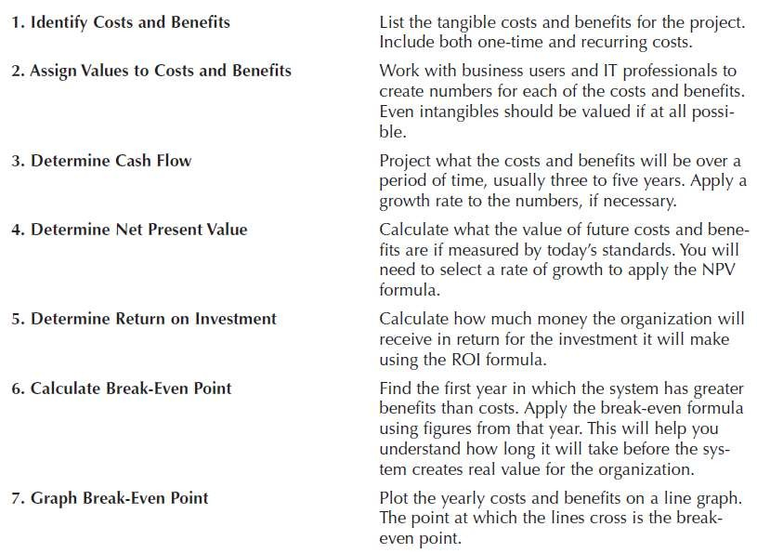
Economic Feasibility: Should We Build It?

Slide 11
Cost-Benefit Analysis - Cash Flow
Project costs and benefits over several years (3–5)
Use normal growth rates for sales etc.
Total added to determine
Overall Benefits = Total Benefits – Total Costs
Higher number is better

Slide 12
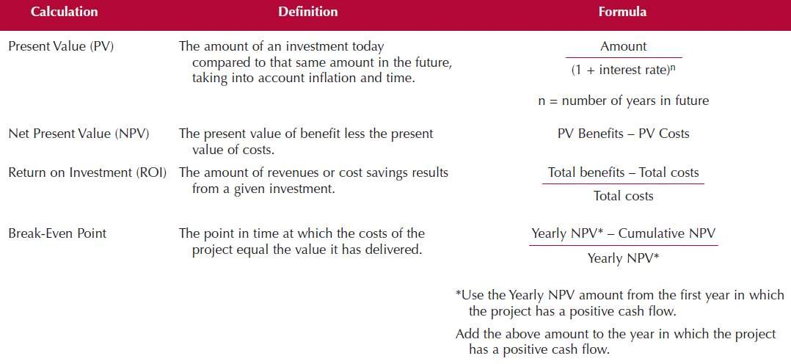
Cost-Benefit Analysis - Cash Flow

Slide 13
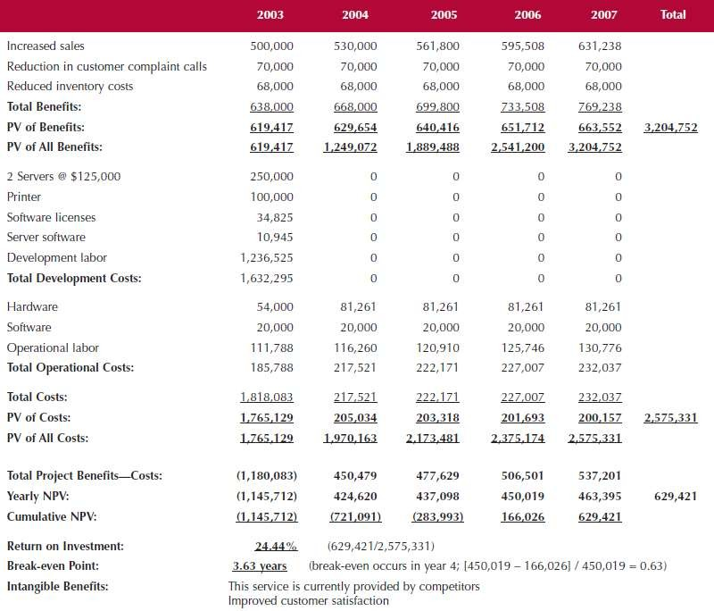
Cash Flow Plan

Slide 14
Present Value (PV)
The amount of an investment today compared to the same amount n years in the future
Taking into account inflation and time
Amount
Present value: current value of a future cash flow
PV =
(1 + Interest Rate)^{n}

Slide 15
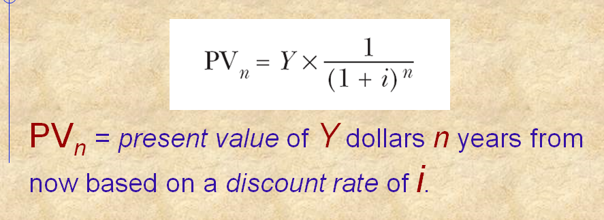
Present Value (PV)

Slide 16
Net Present Value
537,201
(1+ 0.03)⁵
= 463,395
For example, if the discount rate is 3%,

Slide 17
Net Present Value (NPV)
The present value of benefit less the present value of cost
NPV = PV Benefits – PV Costs

Slide 18
NPV Calculation
3,204,752 − 2,575,331
= 629,421

Slide 19
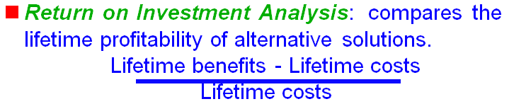
Return on Investment (ROI)
The Amount of revenue or cost savings results from a given investment
ROI =
Total Benefits – Total Costs
Total Costs

Slide 20
ROI Calculation
3,204,752 − 2,575,331
2,575,331
= 0.2444

Slide 21
Break Even Point (BEP)
Calculating your break-even point
To be profitable in business, it is important to know what your break-even point is. Your break-even point is the point at which total revenue equals total costs or expenses. At this point there is no profit or loss — in other words, you 'break even'.

Slide 22
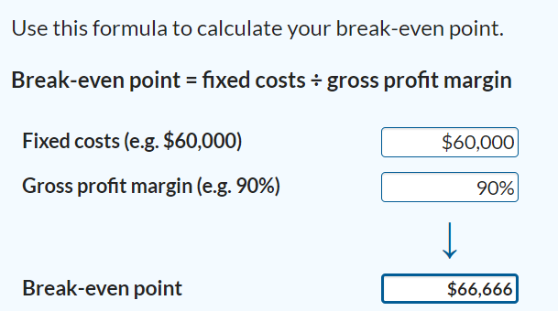
Break Even Point (BEP)

Slide 23
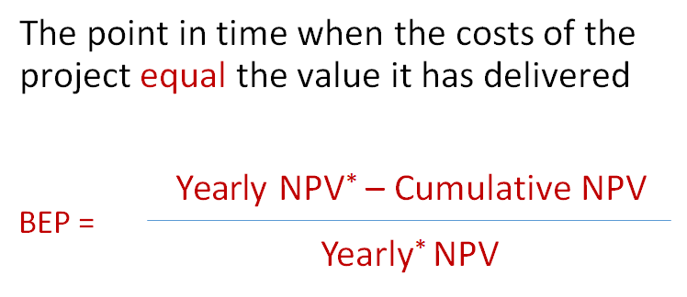
Or
Break Even Point (BEP)
* Use the yearly NPV amount from the first year in which project has positive cash flow

Slide 24
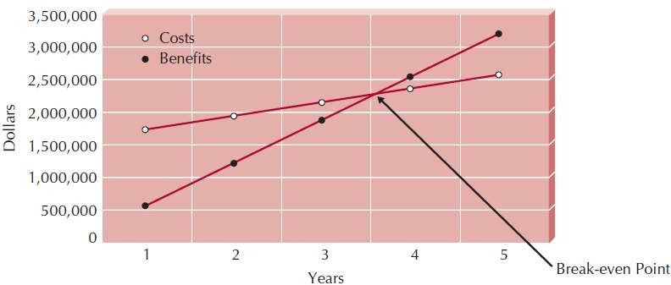
Break Even Point (BEP)

Slide 25
Accounting Methods
Information Systems Analysis and Design
Payback Analysis: how long will it take (usually, in years) to pay back the project, and accrued costs:
Total costs (initial + incremental) - Yearly return (or
savings)

Slide 26
Payback Analysis
Information Systems Analysis and Design
Basically, we need to compute
Total costs (initial + incr.) - Yearly return (or savings) but it must be done with present dollar values.
Cash Flow | Year 0 | Year 1 | Year 2 | Year 3 | Year 4
Dev. Costs | ($100,000)
Oper.Costs |  | ($4,000) | ($4,500) | ($5,000) | ($5,500)
Present Value | 1 | 0.893 | 0.797 | 0.712 | 0.636
Time-adj Costs | ($100,000) | ($3,572) | ($3,587) | ($3,560) | ($3,816)
Cumulative Costs | ($100,000) | ($103,572) | ($107,159) | ($110,719) | ($114,135)
Benefits | 0 | $25,000 | $30,000 | $35,000 | $50,000
T-adj Benefits | 0 | $22,325 | $23,910 | $24,920 | $31,800
Cumulative Benefits | 0 | $22,325 | $46,235 | $71,155 | $102,955
Net Costs+Benefits | ($100,000) | ($81,243) | ($60,924) | ($39,564) | ($11,580)

Slide 27
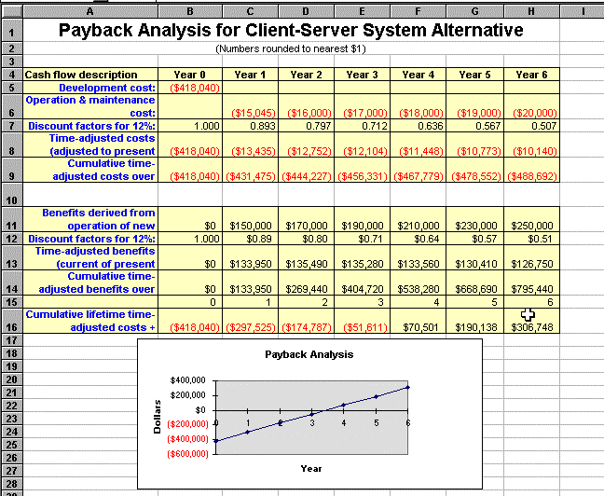
Information Systems Analysis and Design

Slide 28
How to Compute Exactly the Payback Period
Information Systems Analysis and Design
Need to determine the time period when lifetime benefits will overtake the lifetime costs; This is the break-even point.
Determining the fraction of a year when a payback actually occurs:
|beginningYear amount|
(endYear amount + |beginningYear amount|)
For our last example, 51,611 / (70,501 + 51,611) = 0.42
Therefore, the payback period is 3.42 years

